Slide 1

Health Connect Clinic
Final Analytics Report – Week 8
Juliet Chiejina
Data Analytics Track
AnalystLab Africa

Slide 2
Project Overview
HealthConnect wants to reduce missed appointments
Improve attendance and clinic efficiency
My role: Analyse data, identify patterns, and give recommendations

Slide 3
Final KPIs
No-Show Rate: 48%
Attendance Rate: 46.3%
Cancellation Rate: 5.3%
Wasted Appointment Slots: 53.7%

Slide 4
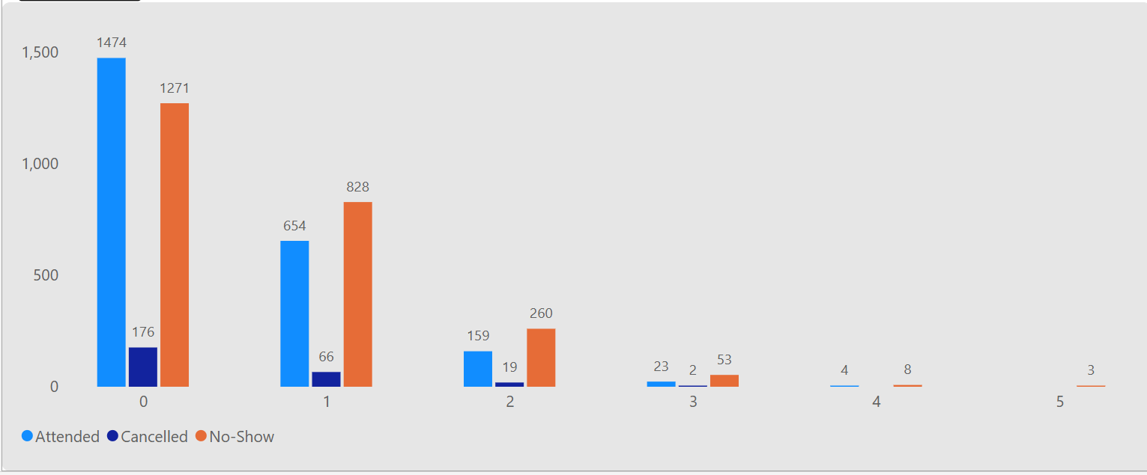
Patients with more previous no-shows are more likely to miss again
No-Show rate increases as previous misses increase
This is a strong predictor of future no-shows
Previous No-Shows

Slide 5
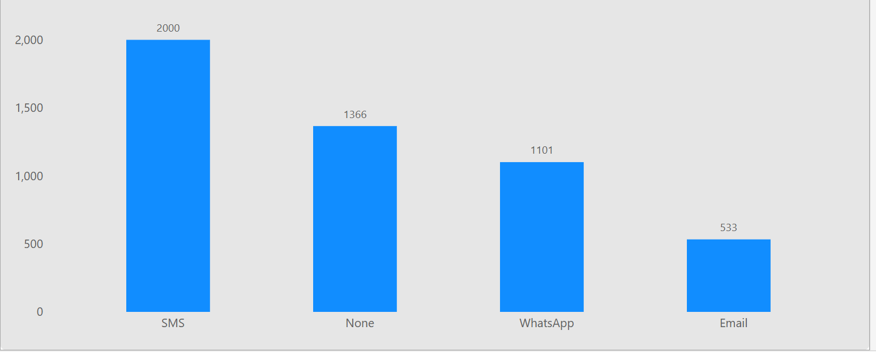
Reminder Channel
SMS performs best among reminder channels
No reminder has the highest no-show rate
Overall, the current reminder system only helps slightly

Slide 6
Cross-Track Collaboration
I collaborated with the Generative AI track.
I shared the finding that SMS is the best-performing reminder channel. They used this information to improve the AI assistant so it now encourages patients to choose SMS reminders.
In return, they improved how the assistant handles incomplete information. This is important because unclear communication can also contribute to missed appointments.

Slide 7
What Causes No Show?
Previous No-Shows (Strongest predictor)
  Patients who have missed appointments before are much more likely to miss again.
  The more times they missed in the past, the higher their chance of missing the next one.
Weak Reminder System
  Even when reminders are sent, the improvement is small.
  SMS is the best channel, but it still leaves a high no-show rate.
  Patients who received no reminder have the highest no-show rate.
Unclear Communication (from peer collaboration)
  patients not getting clear information
Long Booking Lead Time (from peer collaboration)
  Appointments booked many days in advance have higher no-show rates.
  People tend to forget or their plans change.
Distance to Clinic (from peer collaboration)
  Patients who live farther away are more likely to miss appointments.

Slide 8
Recommendations
Strengthen SMS reminders
Flag high-risk patients (previous no-shows)
Reduce long booking lead times
Share findings with Data Science for prediction models
Improve patient communication

Slide 9
Conclusion
No-shows are predictable and can be reduced
Focus on high-risk patients and better reminders
Thank you .

